Slide 1
CSYE 7280 Fall 2022 Final Project
Contributors: Professor: Sparsh Sinha (001000390) Vishal Chawla
Nirmayee Dighe (002984202) &
Rajiv Ranjan Sahu (002101619) TA Team
Sushmita Maity (001092534)
Akshaysingh Bayes (002956209)
Pratik Nakave (001305902)

Slide 2
Overview
Food delivery system has found itself growing ever since we were hit by pandemic.
The purpose of Food-O-Logic is to recognize the pain points of the customer and creating a smooth and seamless experience for the customers.
It is now crucial to understand whether the websites and mobile application used for food ordering can customized to meet the user’s satisfaction.
According to stats online food ordering has now become roughly 40% of the total restaurant sales in the United States.

Slide 3
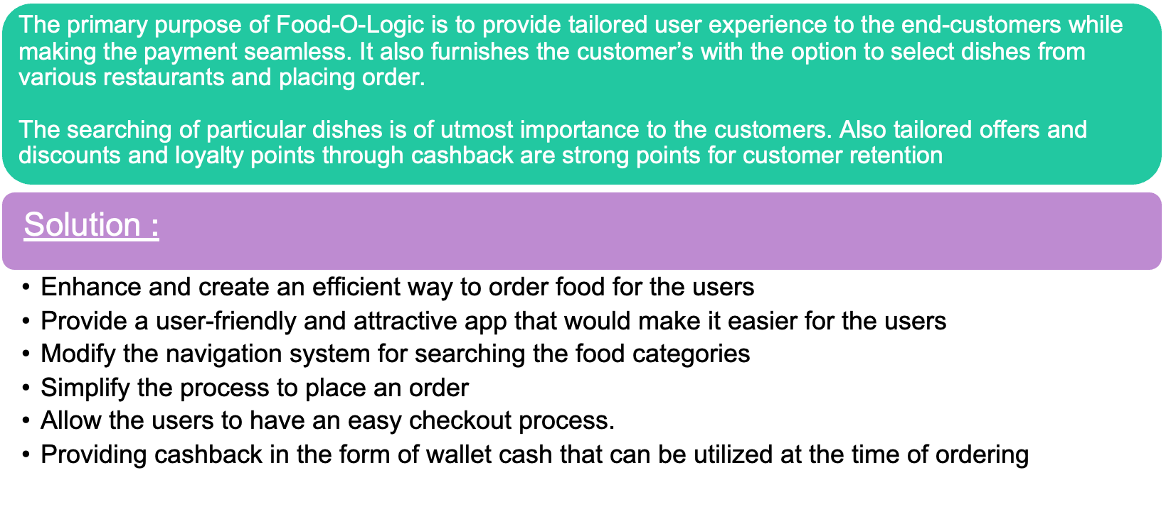
Problem Statement and Solution

Slide 4
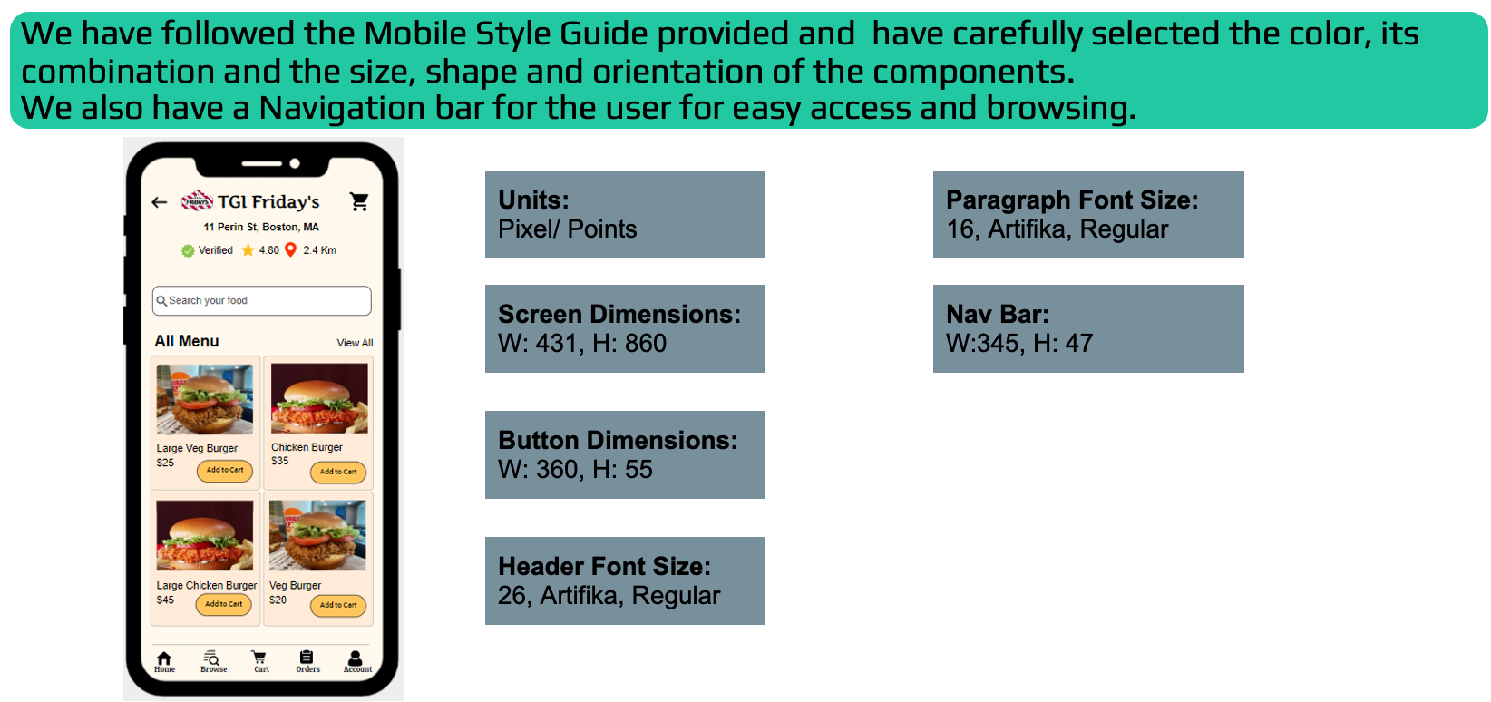
Style Guide

Slide 5
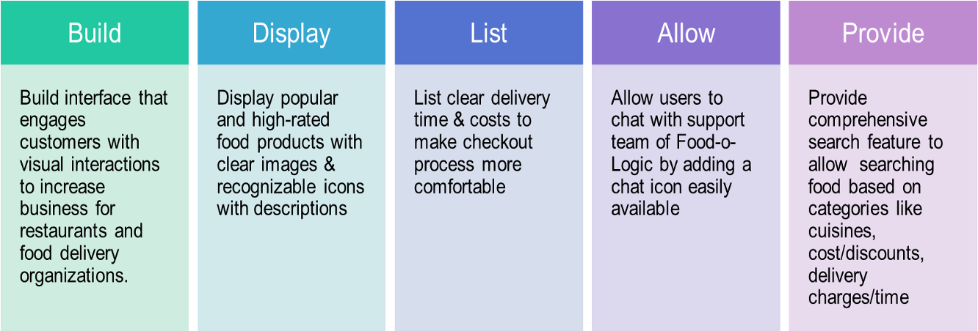
Product Objectives

Slide 6
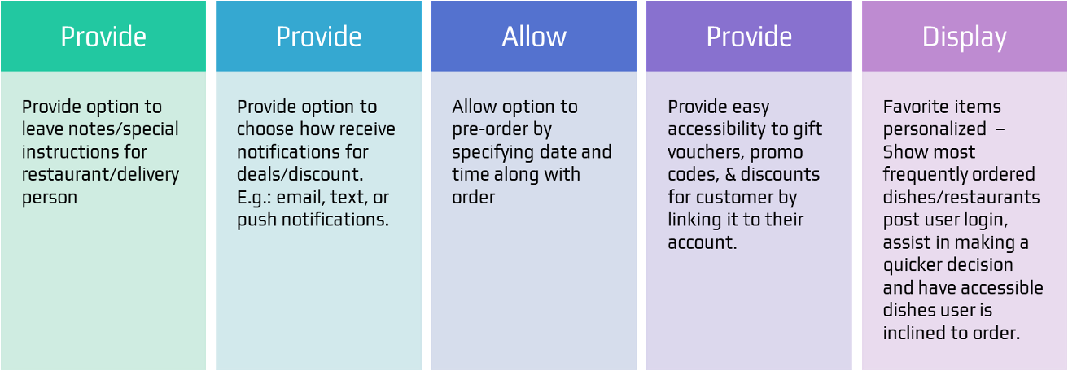
Product Objectives

Slide 7

Target Audience
●Age group – 18 to 65 (Gen Z, millennials, families with young kids)
●Restaurants
●Consumers
●Delivery people

Slide 8
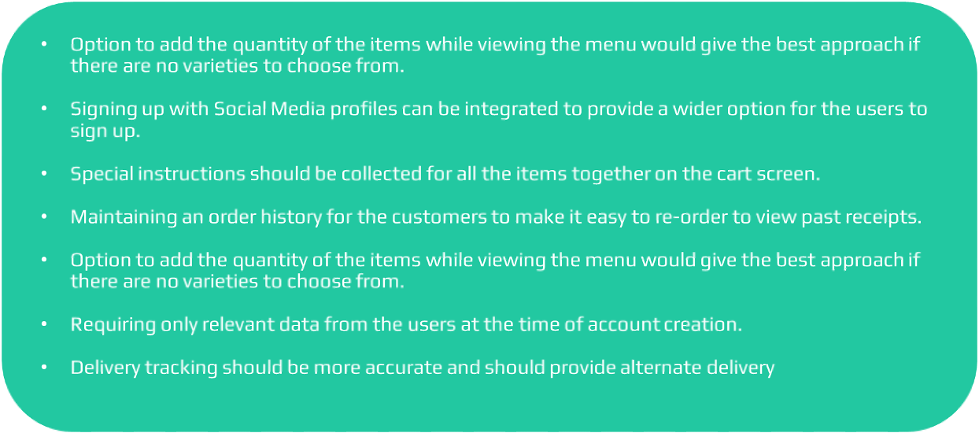
User Needs

Slide 9

Personas

Slide 10
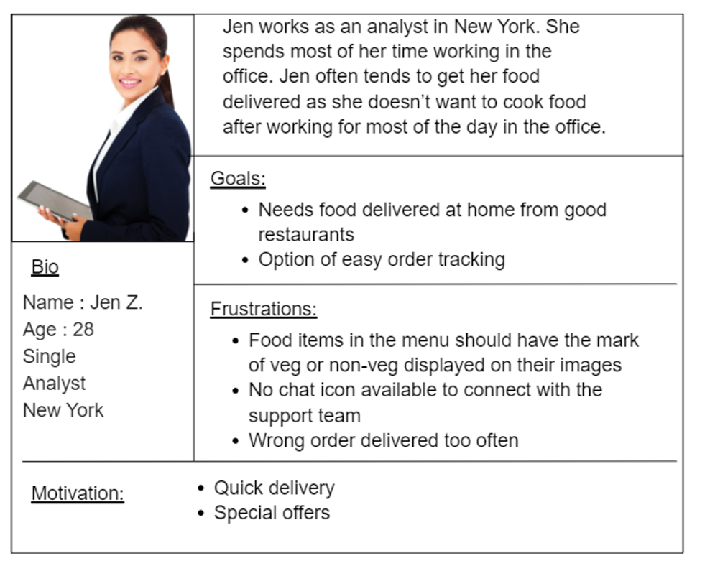
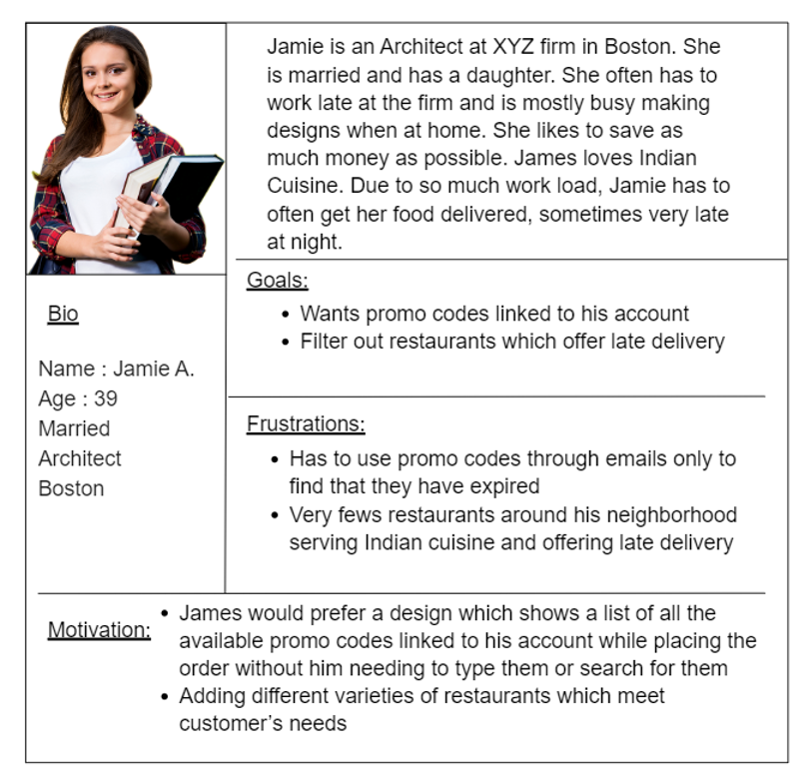

Slide 11
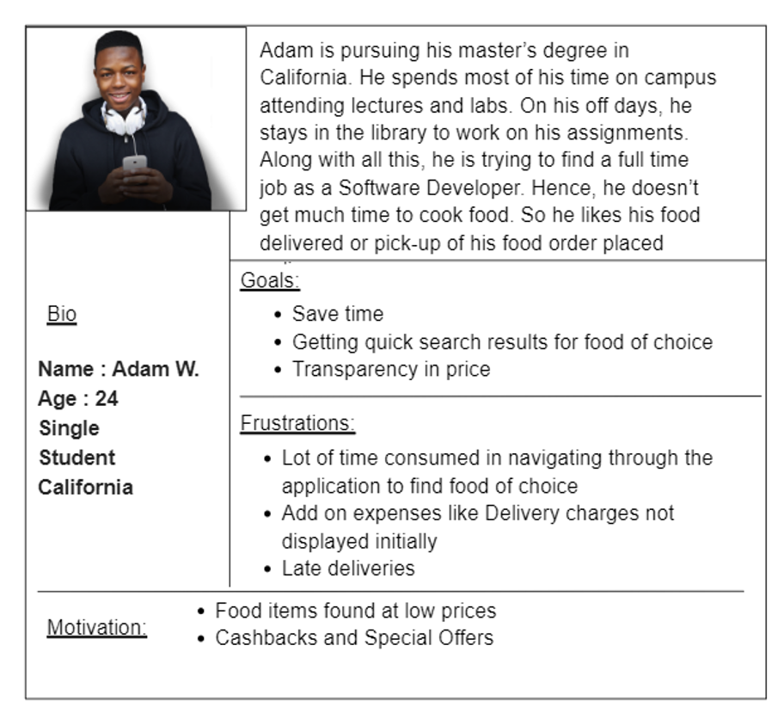
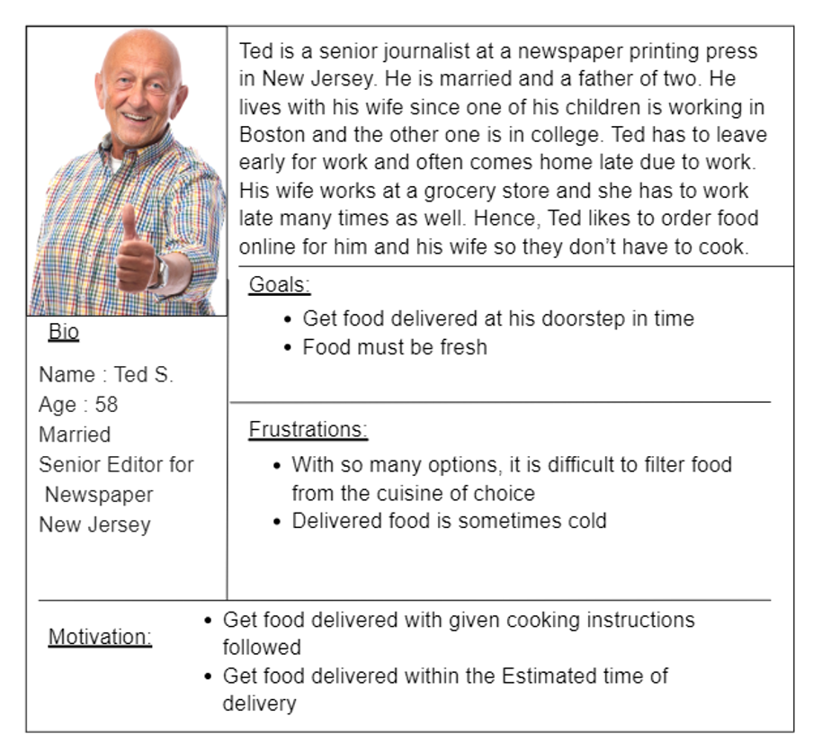

Slide 12
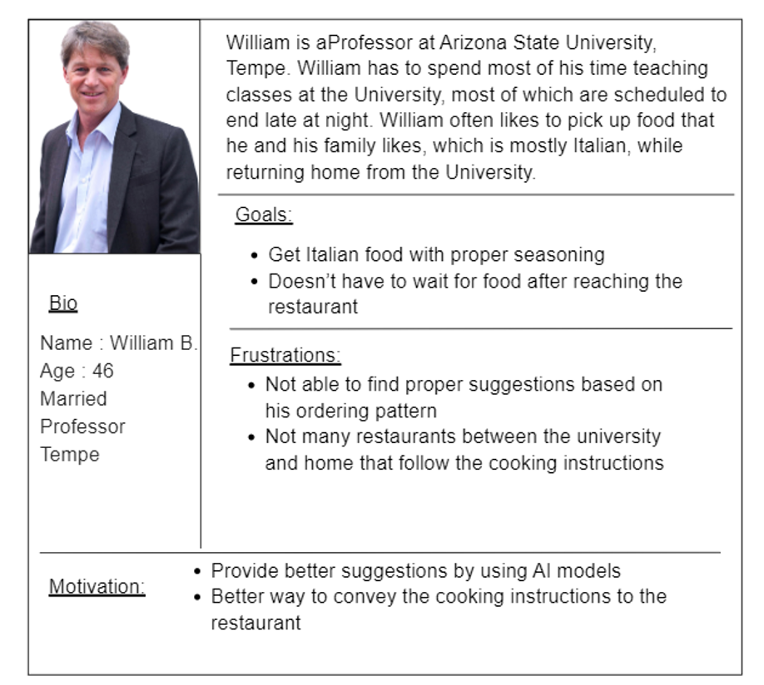
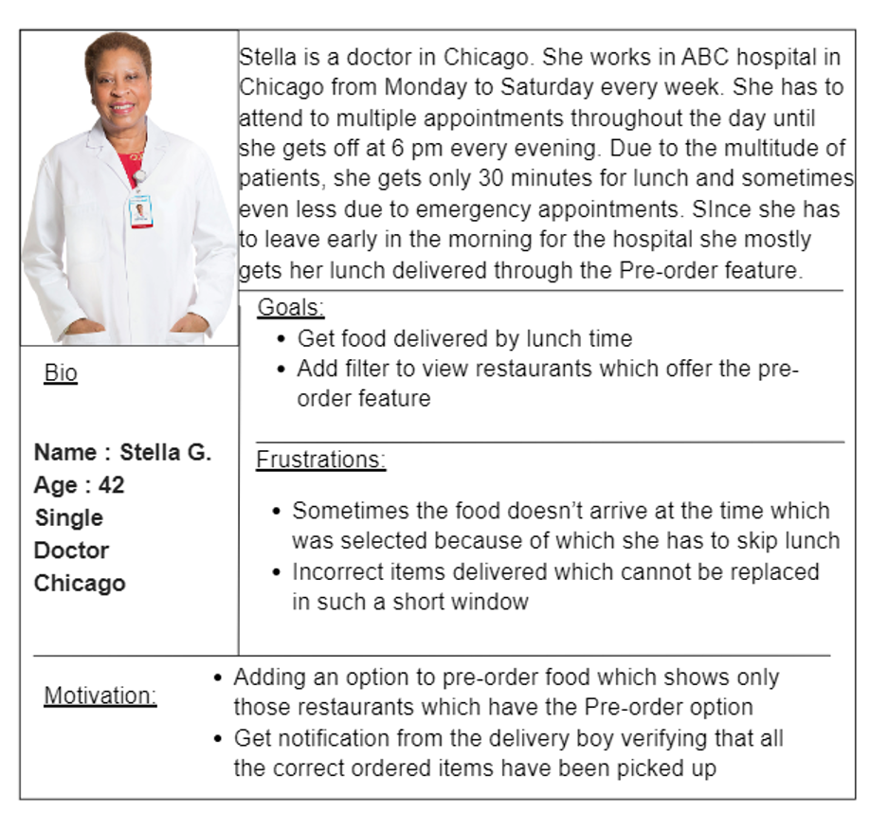

Slide 13

Design Review
Design review is a meeting where the designer shares/presents one or more solutions with their team
The team gives feedback and accepts the proposed solution before developing it.
This meeting is important as the entire team gives feedback to the designer which ensures that the team is on the same page with regards to any project.

Slide 14
Design Review Methodology:
Note the objectives and the expected out come
Ensure that you have enough data to support your solutions. One can also conduct user interviews, or talk with the developers prior to coming up with solutions.
Run multiple tests before presenting your solutions. Try to incorporate as many test cases as possible. The designer must know the solution in and out.
Research on what competitors or others in the market are following. It is important to understand why a company is using a solution and what are the pros and cons of it. This will provide designer with further insights while coming up with a solution
Provide explanations for all the interactions you are using.For example if you include “Sign in with Google” on the Sign Up Page give an explanation: “Importing your profile from google is faster, statistically 89% of the companies saw a growth in subscription rate when they included “Sign in with Google”.
During the design process,if you have to design some interactions, talk with the developers before the design review, ask them for their opinion about the solution, and chat with them about technical aspects.

Slide 15
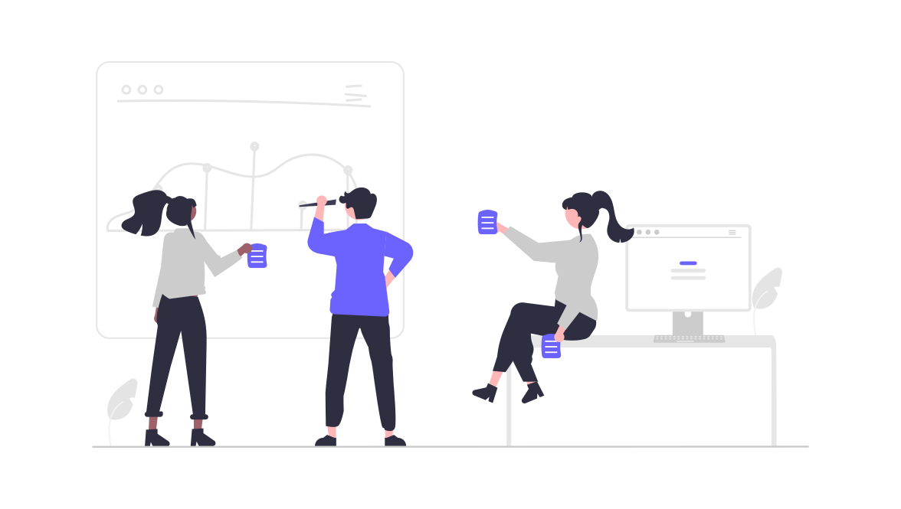
Needs of Design Review:
Verify the outcomes of previous activities.
Identify design issues before committing to further work.
Useful mechanism where the design can be optimized through a systematic review and feedback on design process outputs.
Helps increase visibility across teams and hone’s designers skills at presenting and both giving and reviewing feedback.
Fresh perspective on a problem can help with more creative solutions to the problem.

Slide 16

Benefits of Design Review:
Impacts the products and business of the organization & design teams.
Helps build a common design vision, strategy, and philosophy across the business’s design practice by including design reviews from different product teams during review.
Design consistency & cohesiveness can be achieved among products that are closely related to each other.
Fosters team spirit, share knowledge, and let teams look to each other as resources.
As teams assess the various design challenges their team members face and resolve, they can carry that experience on to their own work.

Slide 17
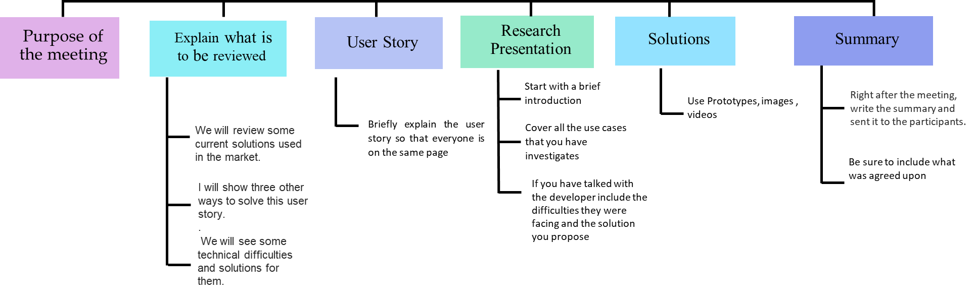
Implementation of Design Review

Slide 18
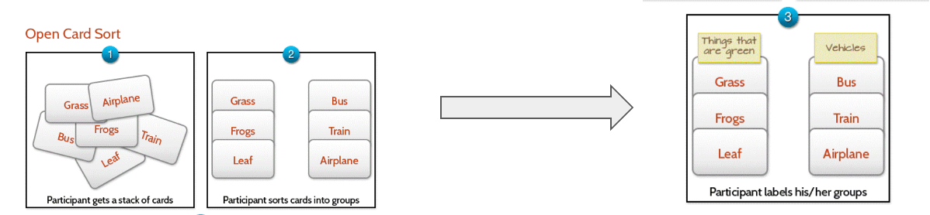
Open Card Sorting
●Each participant is given a stack of cards that are pre-filled out with topics and then asked to group those cards any way they want.
●The participant needs to create labels for the groups that they choose and they don’t have any restrictions for naming.
●This type of sorting is great when you want to design a new website or improve the existing one. By analysing card sorting results, it’s easy to see whether the website structure that you have right now matches up with how people would organize the same information.

Slide 19
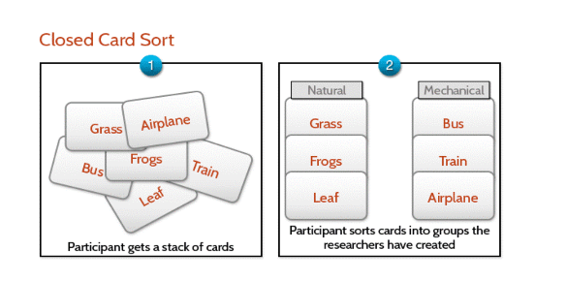
Closed Card Sorting
● Researchers create labels for categories and asks participants to sort cards into predefined categories.
● All participants must do is match content to existing categories.
● This type of card sorting doesn’t reveal how users conceptualize topics, but it helps you understand how well an existing category structure supports the content.
● Closed card sorting works best for prioritizing and ranking features.
For example, you can apply it for search filters in the eCommerce app. Users can distribute all search filters you have in groups ‘Mandatory’, ‘Optional’, or ‘Frequently used’ to ‘I never use it.’

Slide 20
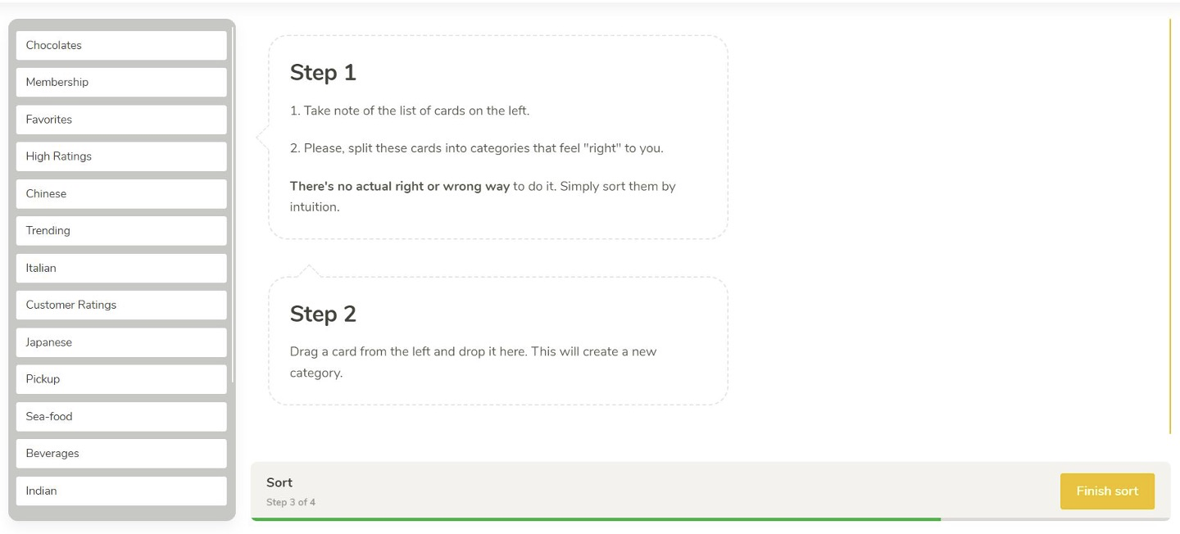
Open Card Sorting

Slide 21
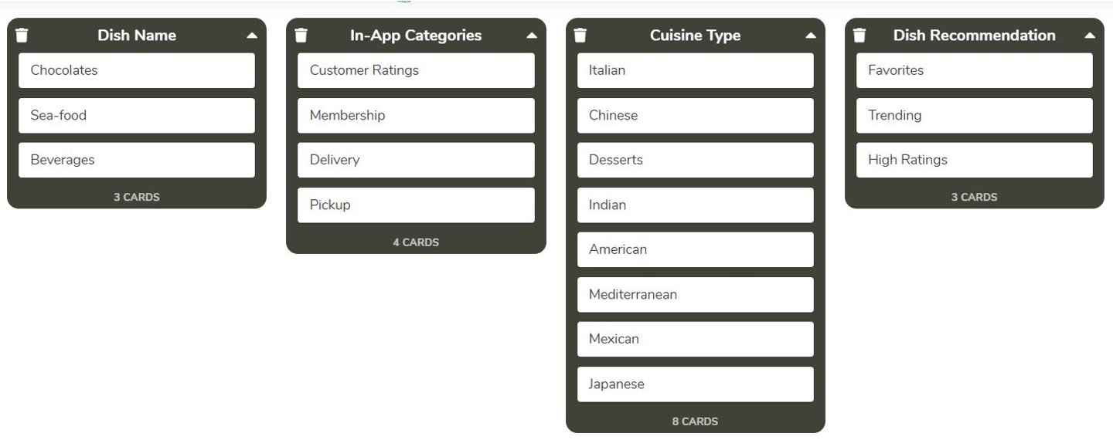
Open Card Sorting By User I

Slide 22
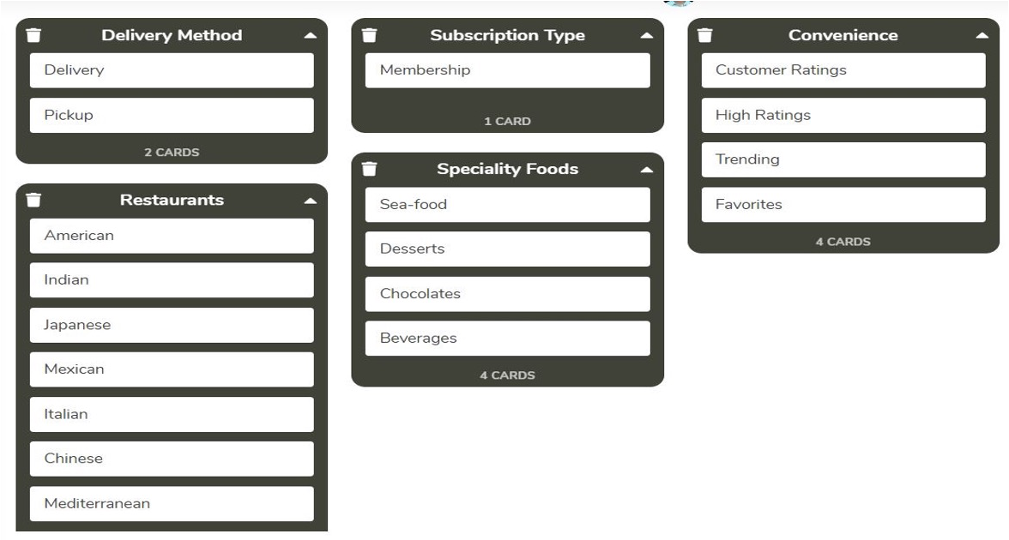
Open Card Sorting By User II

Slide 23
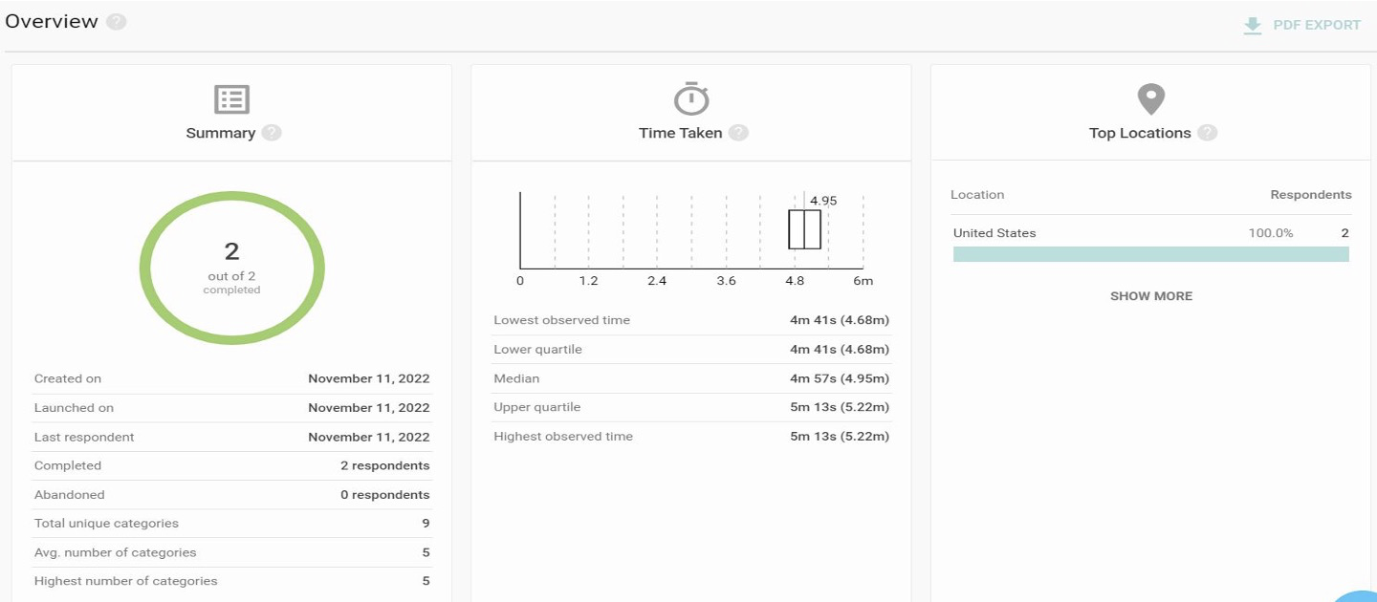
Open Card Sorting Results

Slide 24
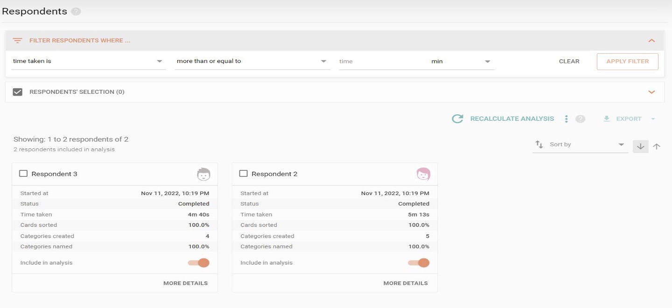
Open Card Sorting Results

Slide 25
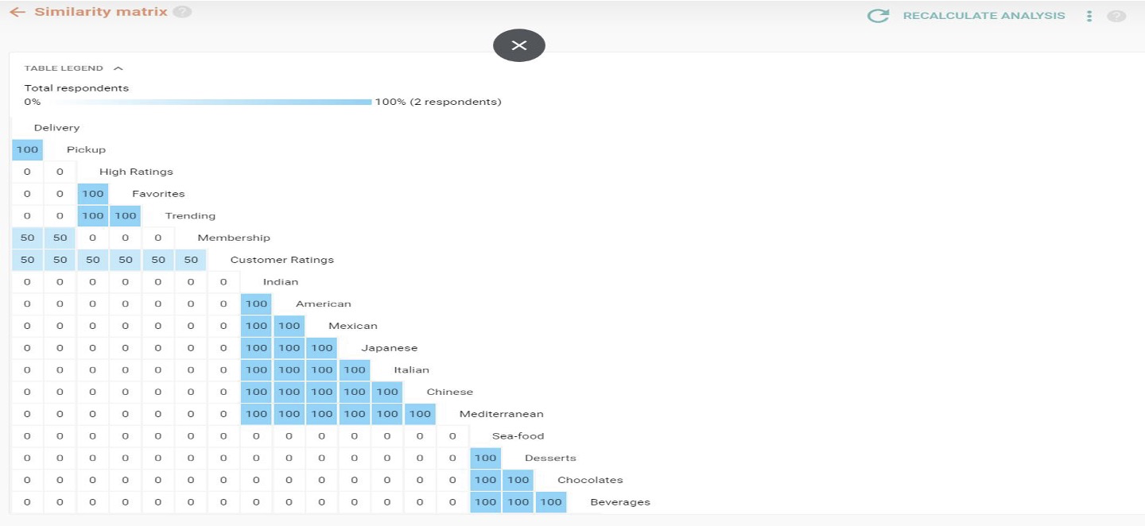
Open Card Sorting Results

Slide 26
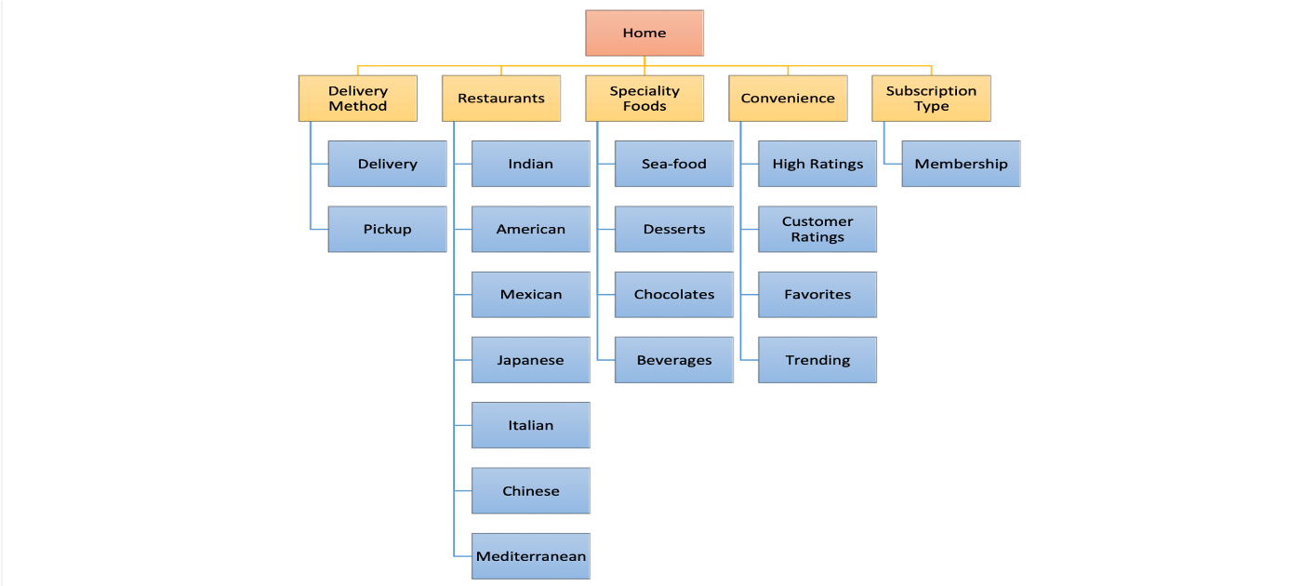
Information Architecture-Open Card Sorting

Slide 27
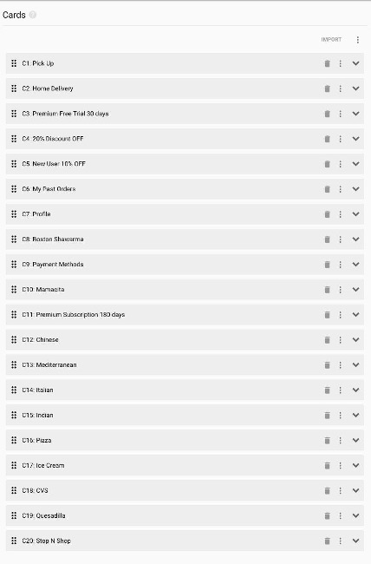
Closed Card Sorting - Cards

Slide 28
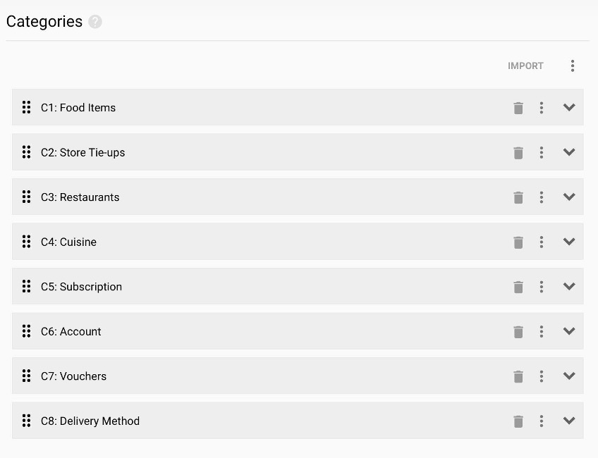
Closed Card Sorting - Categories

Slide 29
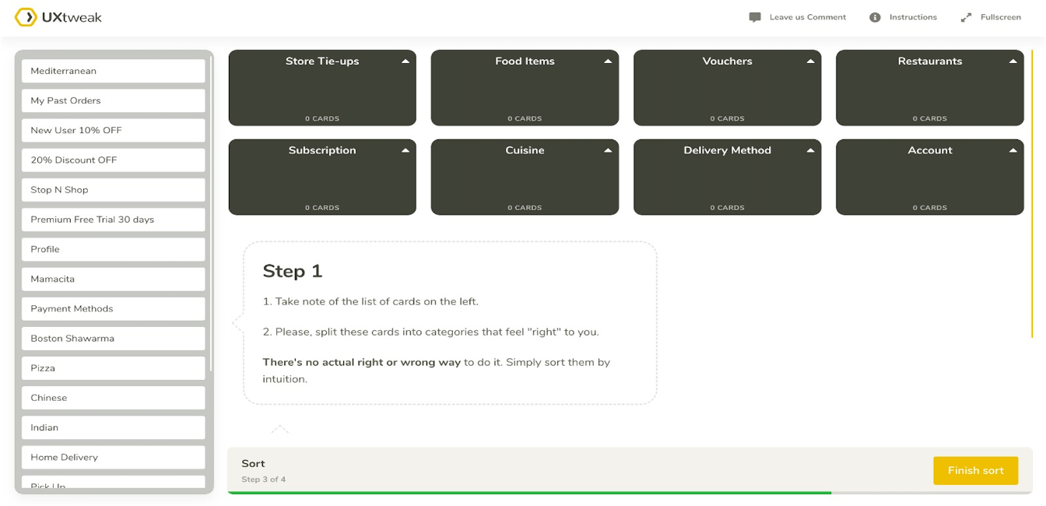
Closed Card Sorting

Slide 30
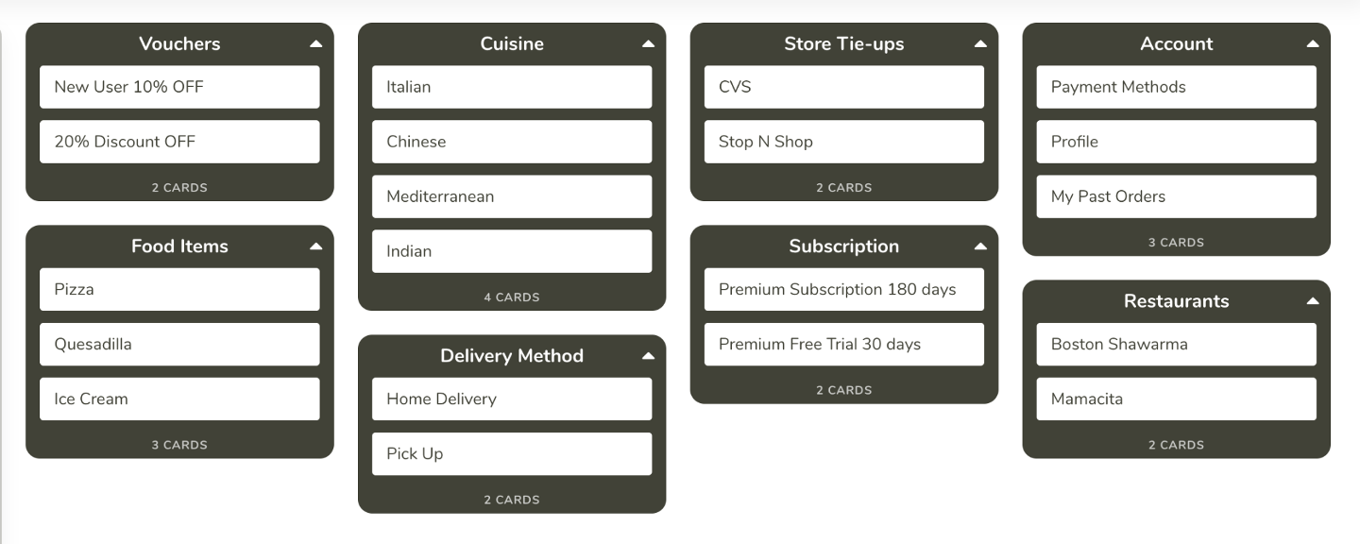
Closed Card Sorting By User I

Slide 31
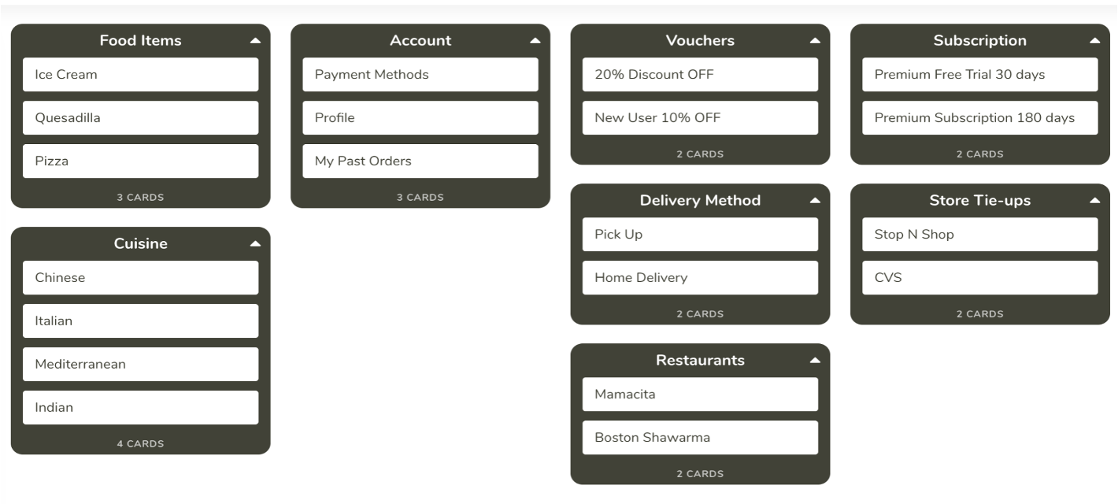
Closed Card Sorting By User II

Slide 32
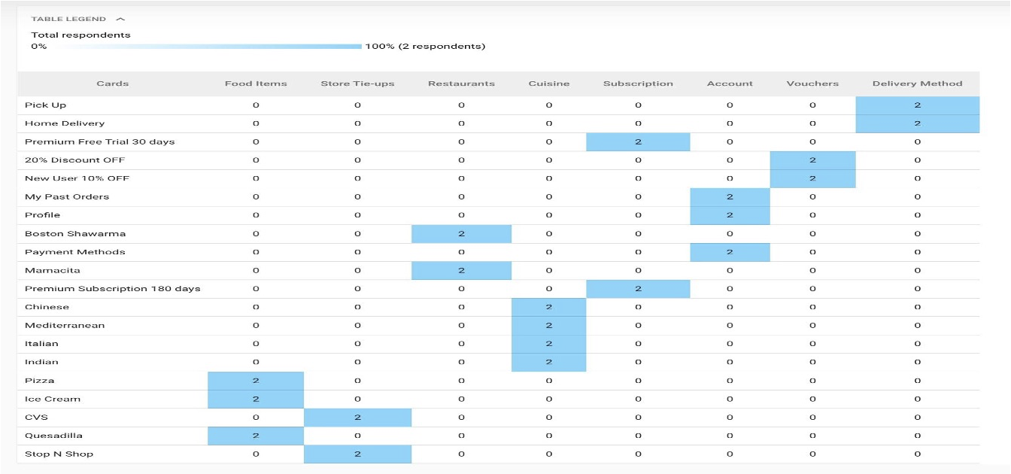
Closed Card Sorting Results

Slide 33
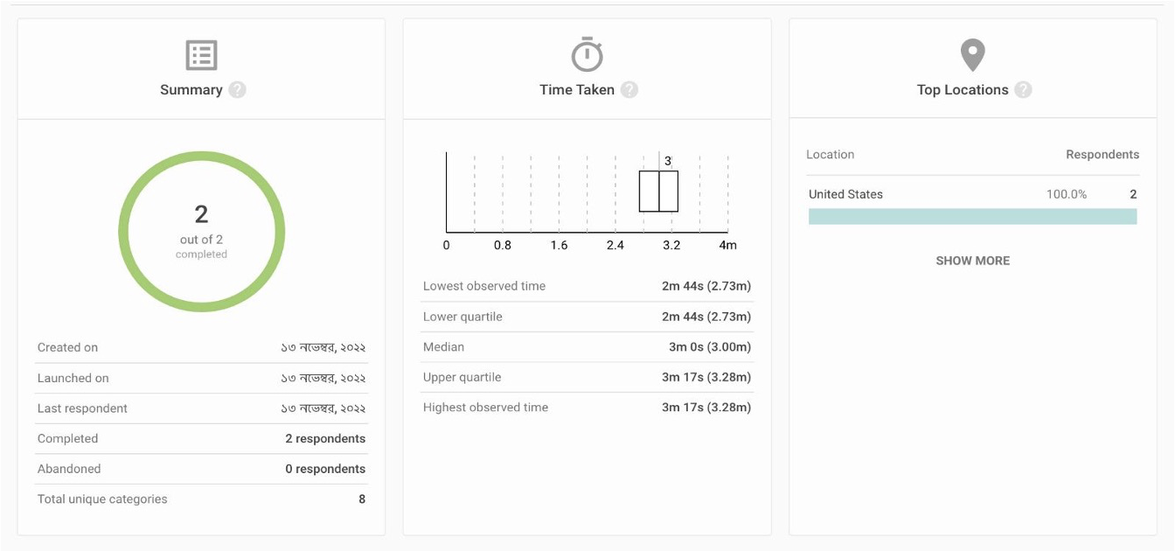
Closed Card Sorting Results

Slide 34
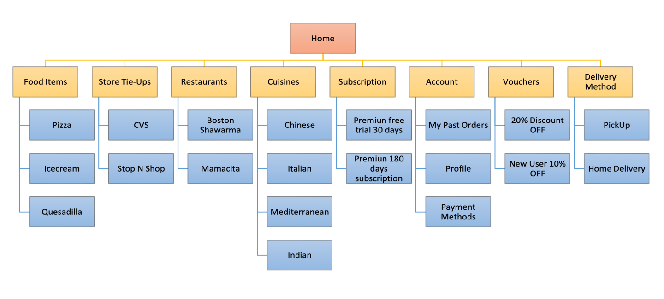
Information Architecture-Closed Card Sorting

Slide 35
Usability Testing
Usability testing states how to evaluate a product or service by testing it with representative users. Usually, during a test, participants will try to complete typical tasks while observers watch.
The goal is to recognize any usability problems, collect qualitative and quantitative data and determine the participant's satisfaction with the product. To run an effective usability test, you need to create a solid test plan, train participants,and analyze and report your findings.
For this project, we run usability test on three of the workflows - Sign Up, Search, Order placing
Users | Sign Up | Search & Filter | Place Order
User 1 | Simple process with onboarding instructions | Sort by cuisine option on home page is efficient | Fast checkout workflow is extremely useful
User 2 | Guest user can proceed to order without signing in | Filters are good at narrowing down results | Placing order is quick and easy
User 3 | Password validation information is added | Searching is efficient | Considers the allergies updated by the user

Slide 36
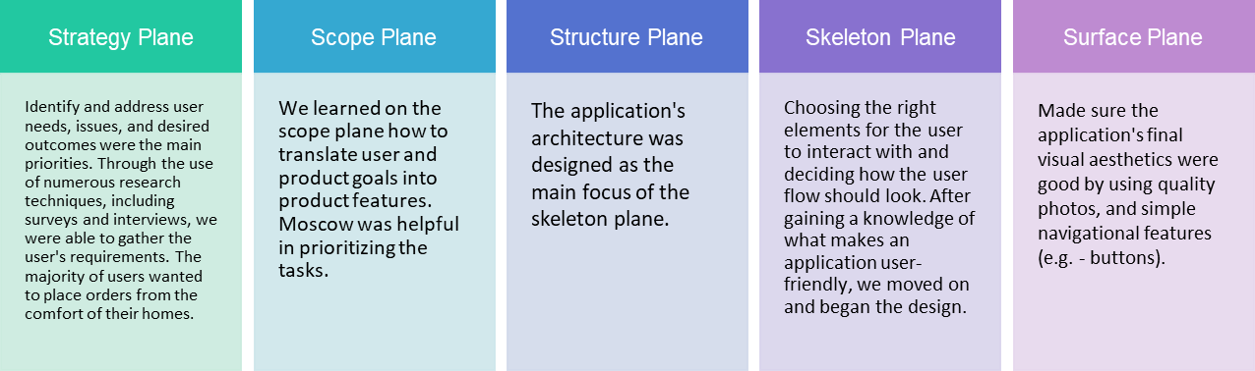
Planes

Slide 37
Error Handling
Error handling is too often an overlooked aspect of UX design. Removing the pain from error experiences is critical because if a user encounters an error, they are probably already frustrated
If chosen to display the error message to the user, it must be ensured that the error message is descriptive, and helps the user solve the problem
It must be ensured that the system should be polite and should not blame the user and the primary objective of error handling in UX is to guide the user to the solution
In Food-O-Logic, we have added error handling at various points. For example, customers will be notified when they enter an invalid email or password during Sign Up or Log In. An error message will also be displayed if the customer enters and invalid promo code during checkout.

Slide 38
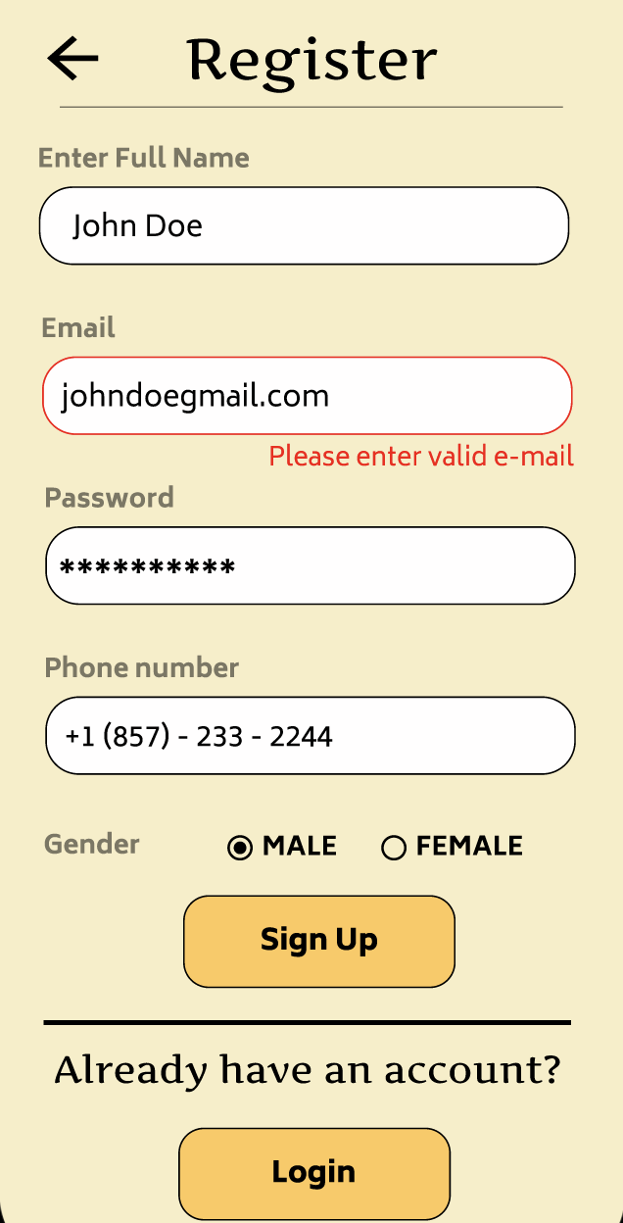
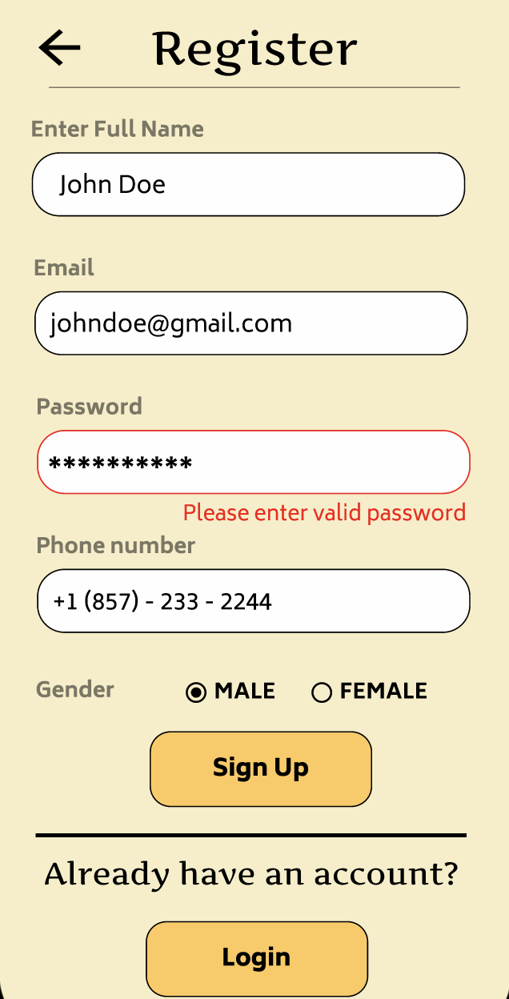
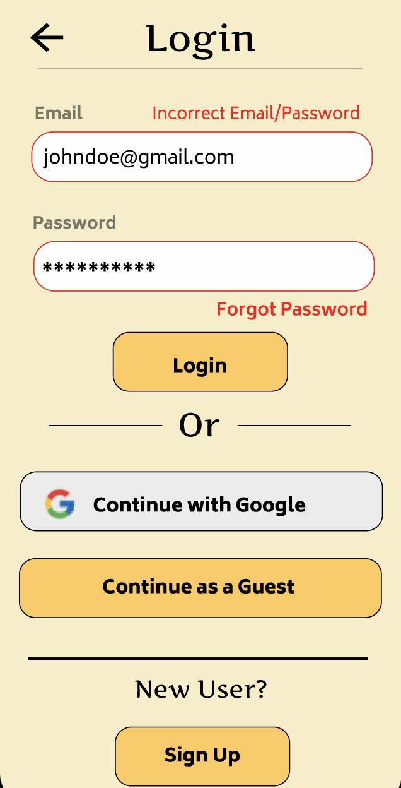
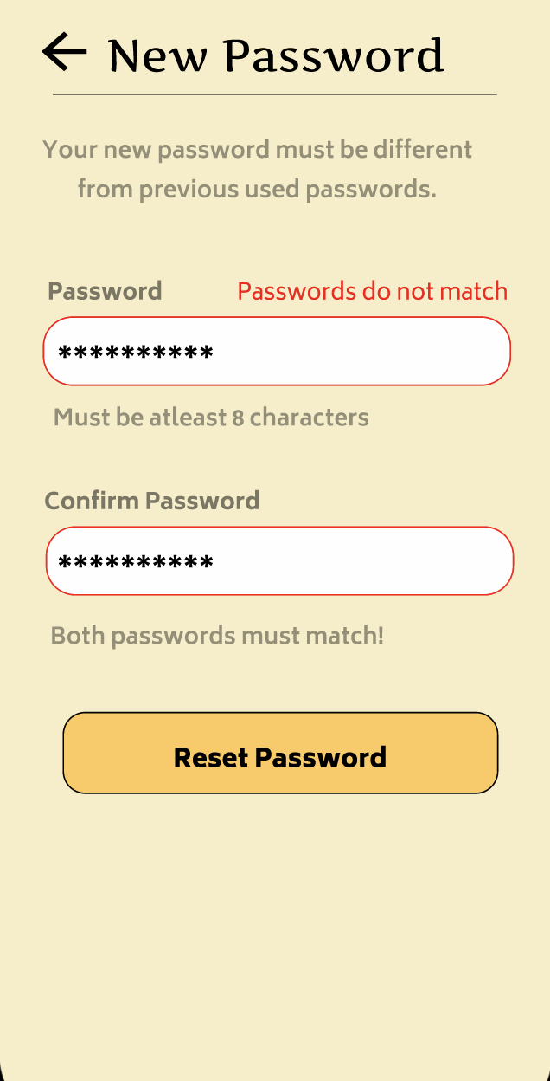
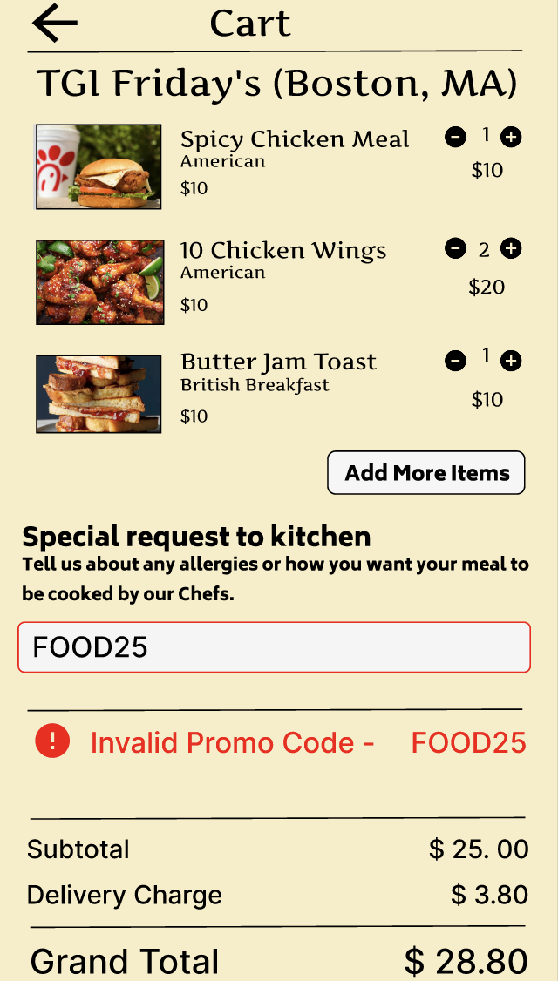
Error Handling - Examples

Slide 39
Plugins, Transitions, Animations
Plugins: Material Design Icons, Icon8
Transitions: Loading screen on launch of App, Onboarding screen vertical scroll, horizontal scroll
Animations: Slide in, Move in(On Drag and On Tap), After Delay

Slide 40

Advanced Features
A common feature in all application these days is the usage of voice assistants that can perform actions based on the voice input
Amazon’s Alexa, Apple’s Siri are very successful implementations of the audio interaction feature. Voice assistants are becoming more common and efficient and users are getting more comfortable with talking to an electronic device as well
The voice command feature is also widely used by specially abled individuals who face difficulty in reading from the screen
Hence, we felt it was necessary to introduce this feature in our application for searching and filtering cuisines/food. You can long press on the button and speak on the mic

Slide 41
Onboarding
Once the user opens for Food-O-Logic, they are directed to onboarding process. For the purposes of our application, we have used Horizontal Scrolling because:
This is a simple, yet effective way of communicating the new or special features that the application has to offer
The application is rather simple to use, and most users are well-equipped with the workings of a food ordering system, hence we do not want to burden the user with unnecessary information

Slide 42
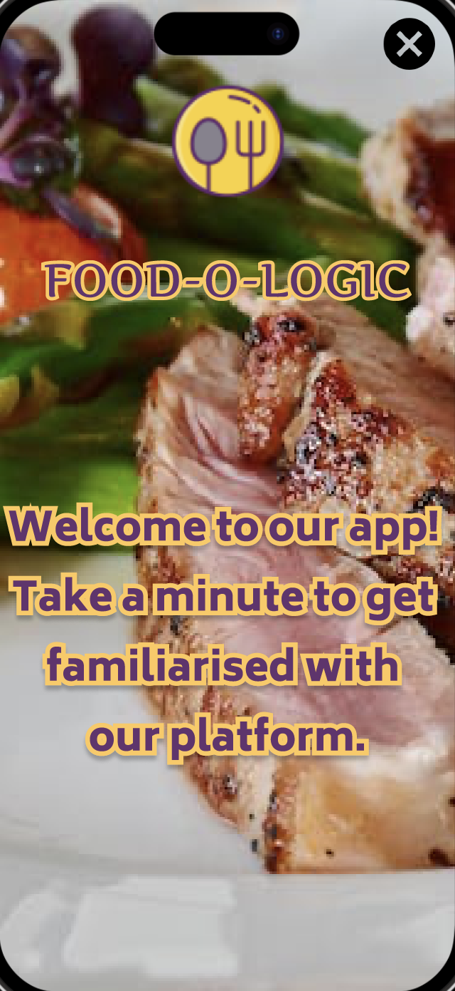
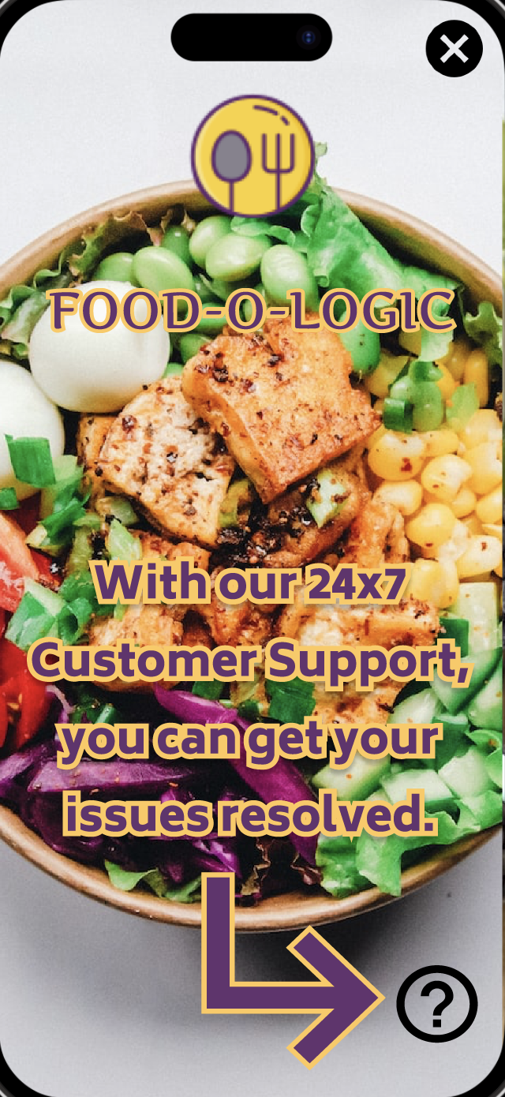
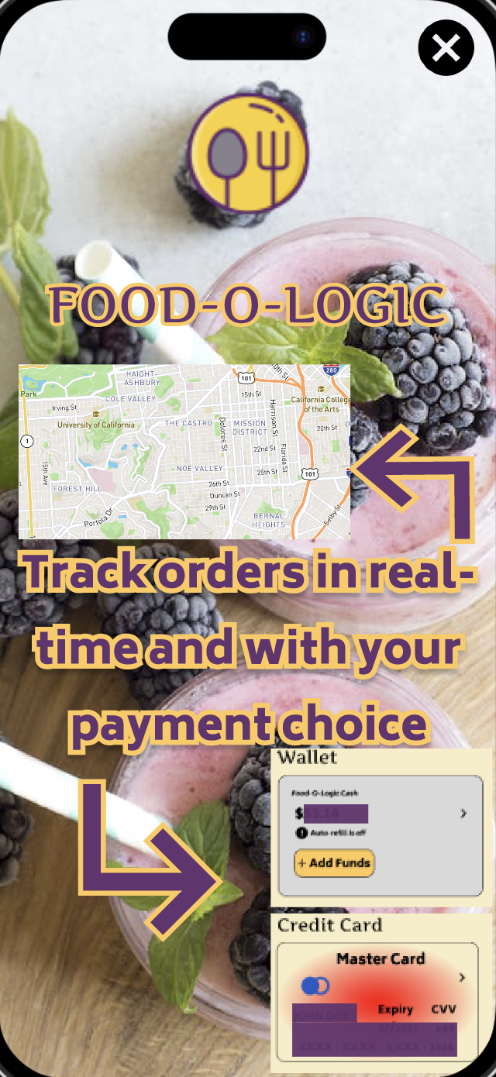
Onboarding - Examples

Slide 43

Questions

Slide 44

- Team 5

